Slide 1
Machine Learning - CLustering
UnSupervised Learning
Groups Similar Datapoints into based on inherit patterns and similarities
Groupings can be done within data not from external
Distance or Similarity between the datapoints calculated
User Defined Library can be modified at runtime also by using Virtual Environment

Slide 2
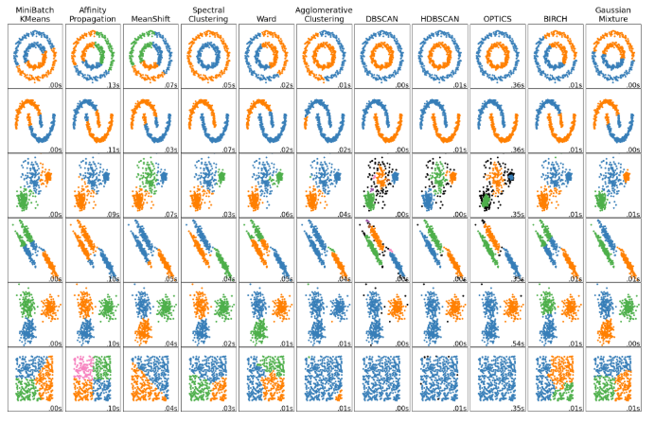
Machine Learning – Clustering - Methods
K-Means
Affinity Propagation
Mean-Shift
Spectral Clustering
Hierarchical Clustering
DBSCAN
HDBSCAN
OPTICS
BIRCH

Slide 3
Clustering Evaluation metrics
1. Rand index
2. Mutual Information based scores
3. Homogeneity, completeness and V-measure
4. Fowlkes-Mallows scores
5. Silhouette Coefficient
6. Calinski-Harabasz Index
7. Davies-Bouldin Index
8. Contingency Matrix
9. Pair Confusion Matrix

Slide 4
K-Means CLustering
Similarity based grouping
With Inertia concept, samples are separated into n groups of equal variance
Euclidean distance used for measuring distance
Random Centroids or Mean is calculated
Each Item categorized with near centroid by iterating all dataset

Slide 5
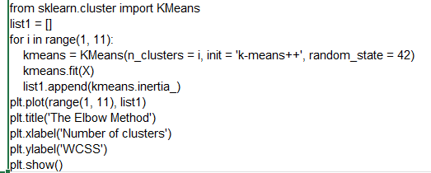
K-Means CLustering

Slide 6
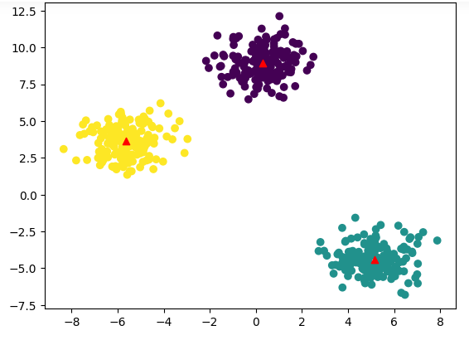
K-Means CLustering
Diagram shows the dataset plots as cluster
Red Mark is the Centroid of each cluster

Slide 7
Affinity Propagation CLustering
Creates Clusters by sending messages between pairs of samples until convergence
Exemplars created from dataset
Representative members of the cluster is Exemplars
Iteration of dataset until convergence
Parameters are:
Preference – To Control the Exemplars
Damping factor – Number to avoid the oscillations

Slide 8

Affinity Propagation CLustering
Advantages:
Automatically determines the number of clusters.
Can be effective for datasets with varying densities.
Disadvantages:
Complexity
Computationally expensive, especially for large datasets.
May produce many small clusters or have difficulty converging on some datasets.

Slide 9
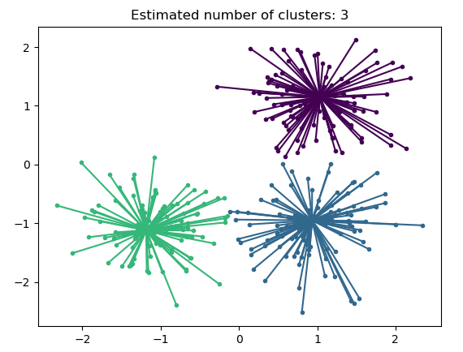
Affinity Propagation CLustering

Slide 10
Mean shift CLustering
Centroid based Algorithm
Datapoints will be located themselves with the centroid
Iteration repeats for centroids and new centroids appears
Those centroids moves to higher density region
Iteration stops when change in centroids is small
Number of clusters determines by Algorithm not in advance

Slide 11

Mean shift CLustering
Advantages:
Automatically determines the number of clusters.
Can be effective for datasets with varying densities.
Disadvantages:
Complexity
Computationally expensive, especially for large datasets.
May produce many small clusters or have difficulty converging on some datasets.

Slide 12
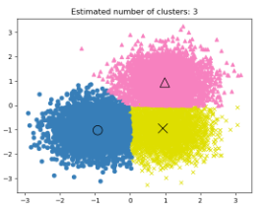
Mean shift CLustering

Slide 13
Spectral clustering
Groups datapoints based on similarity into clusters
Eigenvalues and Eigenvectors used to forecast low dimensions space for clustering
Datapoints are represented as nodes
Similarity represented as edge

Slide 14

spectral CLustering
Advantages:
Scalability
Robustness
Flexibility
Disadvantages:
Complexity
Model Selection

Slide 15
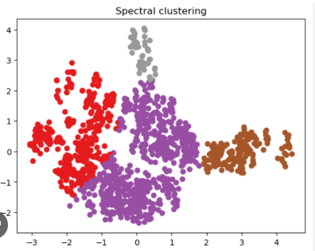
Spectral CLustering

Slide 16
DBScan clustering
Density-Based Spatial Clustering of Applications with Noise
Group points that are closely packed together in dataspace
clusters can be found in any shape and convex shaped.
views clusters as areas of high density separated by areas of low density.
Finds core samples of high density and expands clusters from them

Slide 17

DBScan CLustering

Slide 18
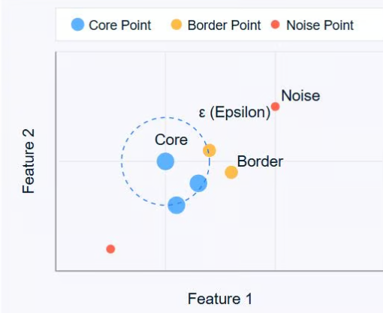
DBScan CLustering
Three key concepts:
Core Points:
Having minimum number of other points with specified distance
Border Points:
Points within the distance of core point
Noise Points
Points neither core points nor border points

Slide 19
HDBScan clustering
Hierarchical Density-Based Spatial Clustering of Applications with Noise
Clustering criterion is globally homogeneous
Extracts the minimum spanning Tree from fully connected mutual reachability graph
Then cuts the edges with highest weight

Slide 20

HDBScan CLustering

Slide 21
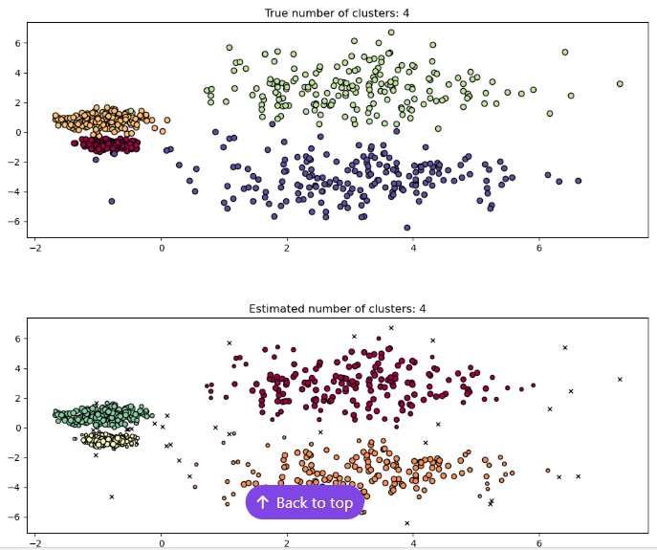
HDBScan CLustering

Slide 22
OPTICS clustering
Ordering Points To Identify the Clustering Structure
Density Based Clustering algorithm, similar to DBSCAN
Designed to handle datasets with varying densities
It calculates the ‘core distance’
determines the maximum of the core distance of one point and the actual distance between 2 points
Creates Reachability point
Cluster and Ranges identifies

Slide 23

OPTICS CLustering

Slide 24
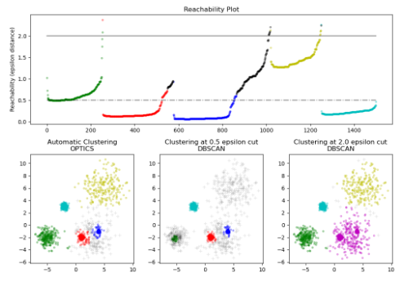
OPTICS CLustering

Slide 25
BIRCH clustering
Balanced Iterative Reducing and Clustering using Hierarchies
Large datasets can be clustered
Cluster is formed from the summary of datapoints
Summarizes data into Tree-like structure called Clustering Feature tree
Applies clustering algorithm on the leaves of CF Tree
CF Tree has number of subclusters
Subclusters located in the Non terminal CF Tree

Slide 26

BIRCH CLustering
★ Count
The number of data values in the cluster.
★ Linear Sum
The sum of the individual coordinates. This is a measure of the location of the cluster.
★ Squared Sum
The sum of the squared coordinates. This is a measure of the spread of the cluster.

Slide 27
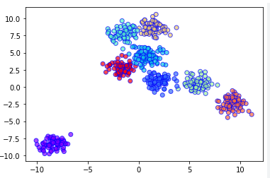
BIRCH CLustering

